Slide 1

Predicting Geographical
Employment Trend For
Different Occupations Across US
By StochasticFisher
Team Members:
Yunliang Chen
Pei Zhou
Shenghao Xu
Xuening Zhang
Yuan Zhang

Slide 2
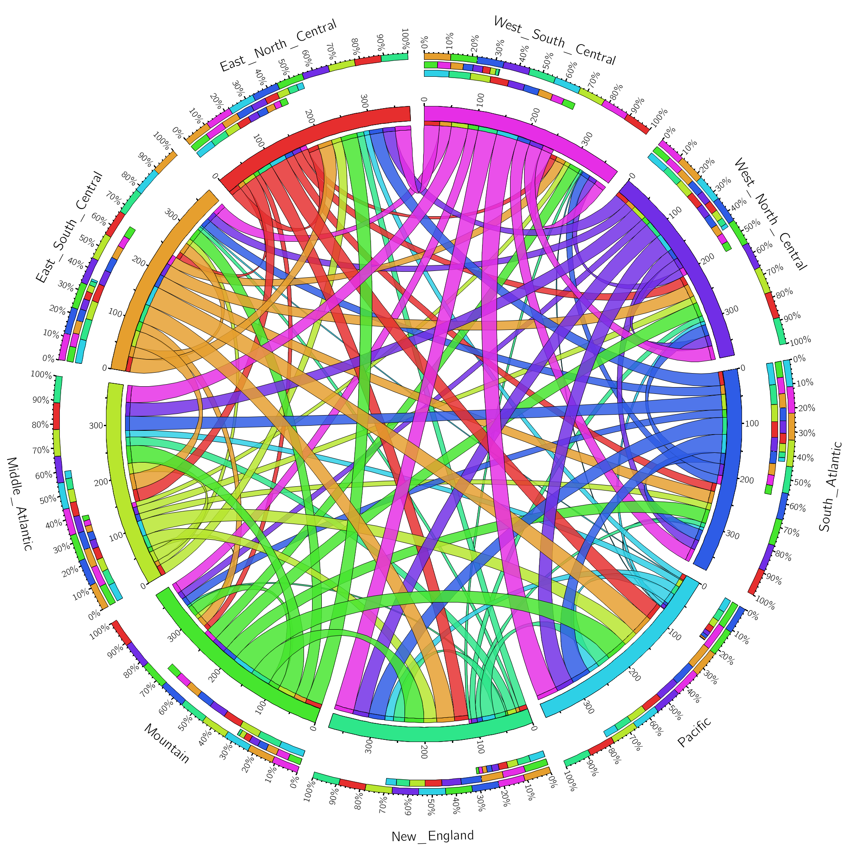

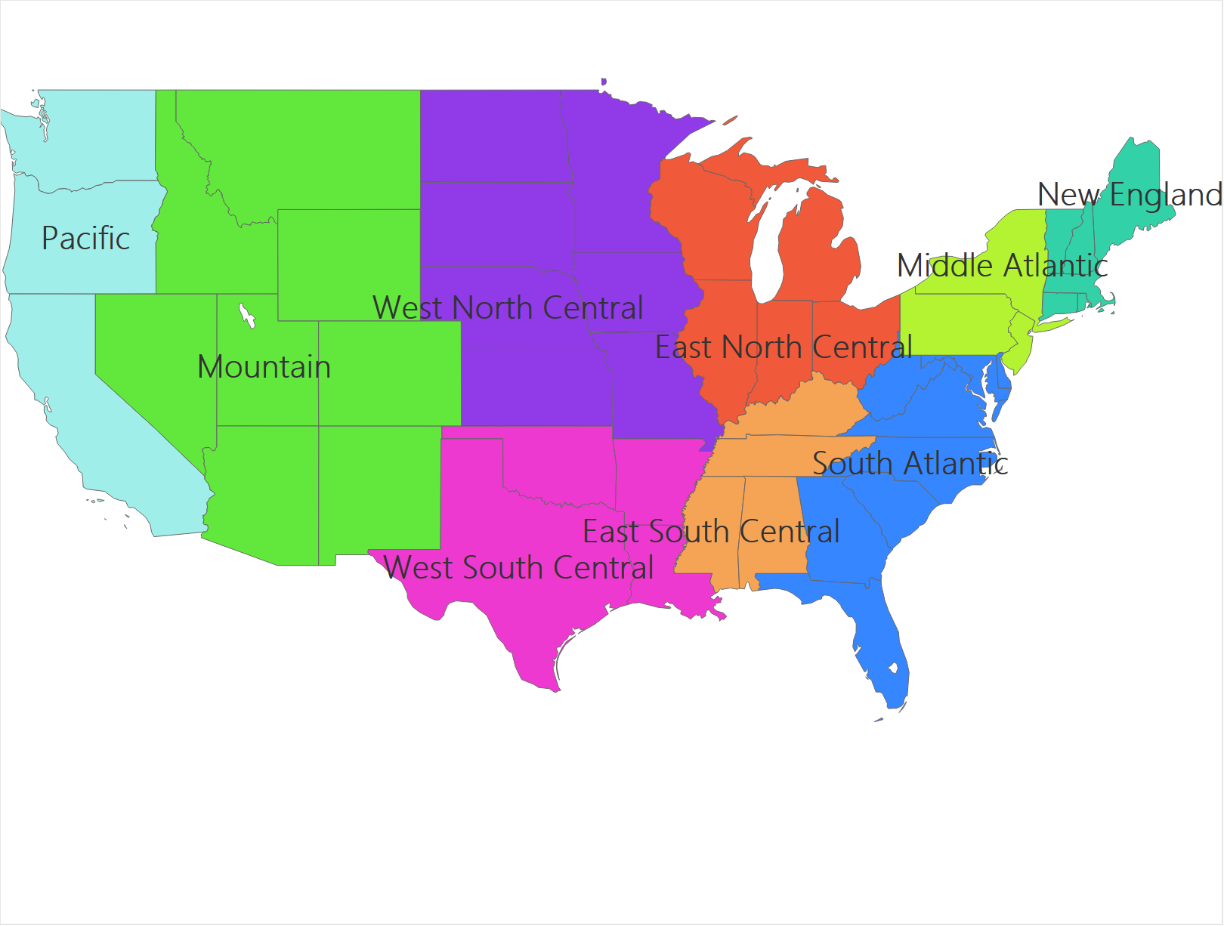
Geographical migration
Methodology:
Markov Chain Model
Transition Matrix
PageRank
Score for Each Division:

Slide 3
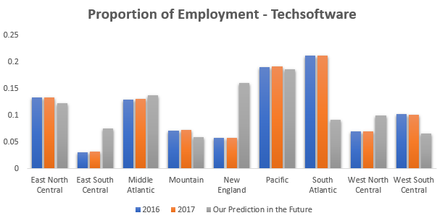
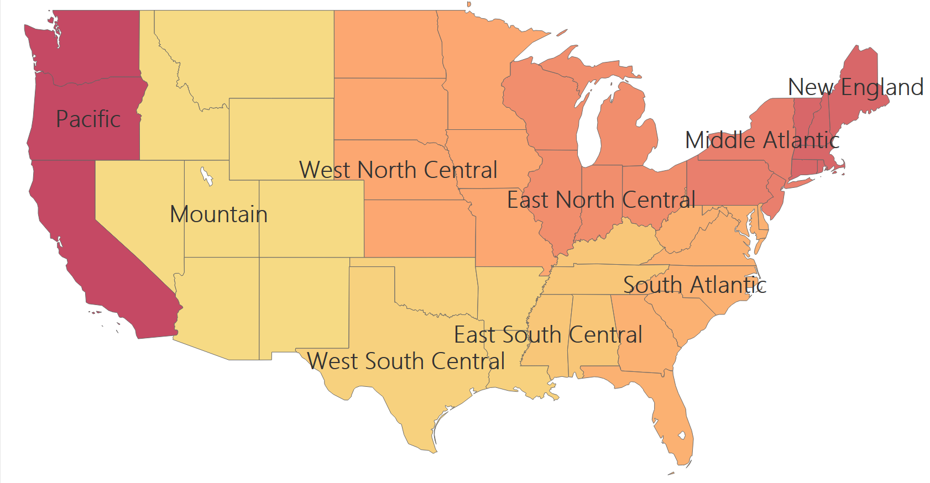
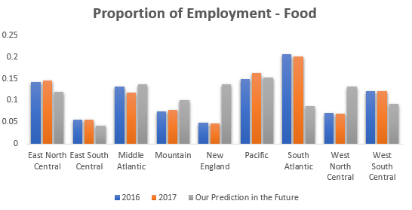
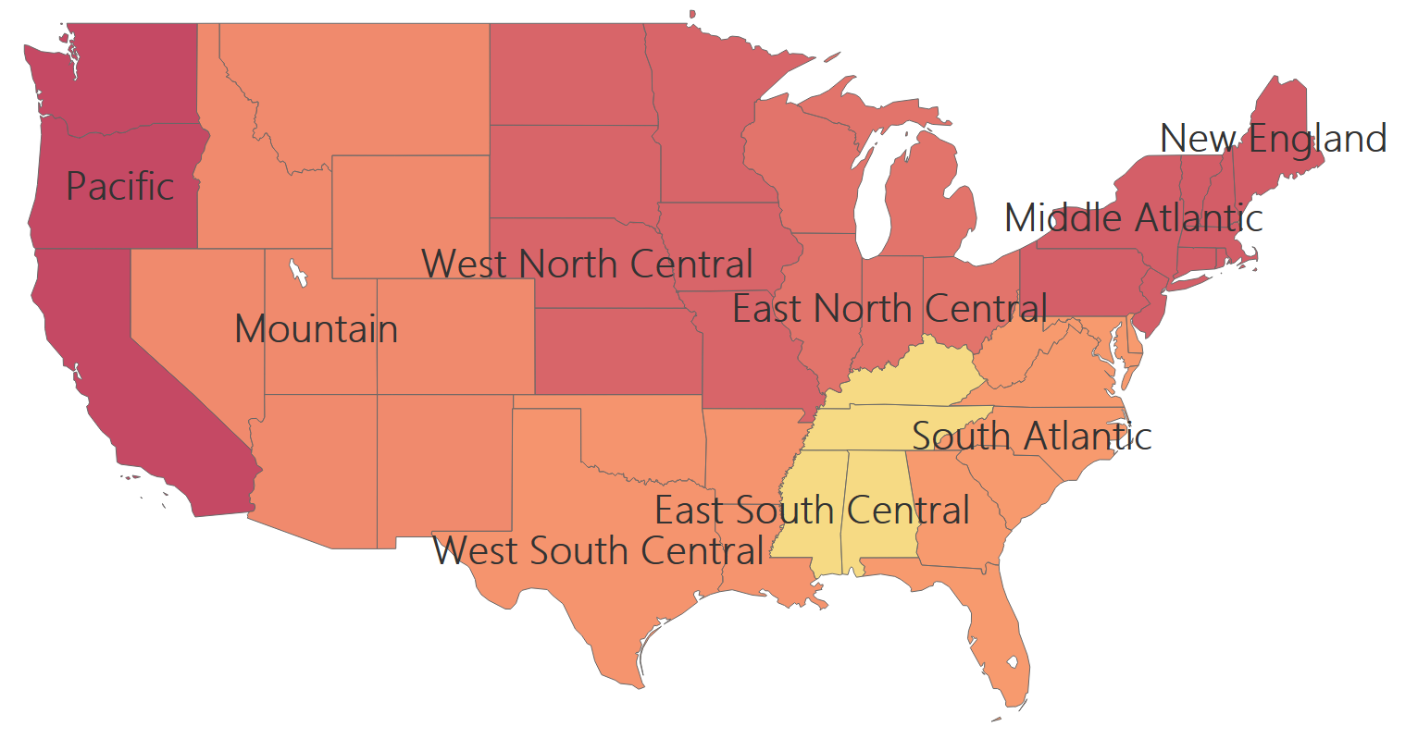
Prediction
TechSoftware:
Food:

